Slide 1


Intro to ML and NLP with scikit-learn
Document Classification Use Case

Slide 2
Follow Us
meetup.com/DataSciencePros/
Code:
https://github.com/DataSciencePros/data_science_workshop
Notebook 3 on Colab: https://colab.research.google.com/drive/1eARCOQj3E7SLy2LFbNZAREprdCIa89tP?usp=sharing
Notebook 4 on Colab: https://colab.research.google.com/drive/1GHJTCqO5IittuYx3rjCMaQaXbyWqkzfw?usp=sharing

Slide 4
Examples of Machine Learning
Medicine, Computational Biology
diagnostic expert systems, tumor detection, drug discovery, DNA sequencing
Play games; chess, go, poker, flappy bird…
Computational finance
credit scoring, algorithmic trading
Marketing
Ad targeting, lead prediction

Slide 5
More Examples of Machine Learning
Voice Recognition, Text-to-speech
Text Data, NLP
classifying/clustering articles, resumes, human profiles
spam detection
translation
Recommending
a product to buy
next movie to watch
next date (matchmaking)

Slide 6
Notes:
https://www.mathworks.com/discovery/machine-learning.html

Slide 7
(Supervised) Machine Learning Defined
A process by which computer learns how to be successful at a certain task without being explicitly programmed to do so
Algorithms use the definition of success to fit a model that transforms the input into an output
Chooses best features to predict output
Finds best parameters/thresholds to create the function (model) that predicts the value closest to actual output in given training examples
This model is used to predict output for new cases

Slide 8
Notes:
https://www.mathworks.com/discovery/machine-learning.html

Slide 9

http://scikit-learn.org/stable/tutorial/machine_learning_map/

Slide 10
Scikit-Learn Terminology
Input data
2-dimensional NumPy array usually named `X`
each column is a feature, each row is a sample
each sample (row) has a corresponding target value (label)
label can be a continuous value (e.g. price) or a category (e.g. spam/not spam).
labels are separated into their own array, usually named `y`
Estimator is the Python object that learns from the data. We use it to train (fit) the model, and use model to make predictions. Model is stored in this object

Slide 11
Scikit-Learn
Easy to use
train a model in 3 lines of code
other tools for data preprocessing and model evaluation
Does not focus on Deep Learning
Built on top of NumPy library

Slide 12
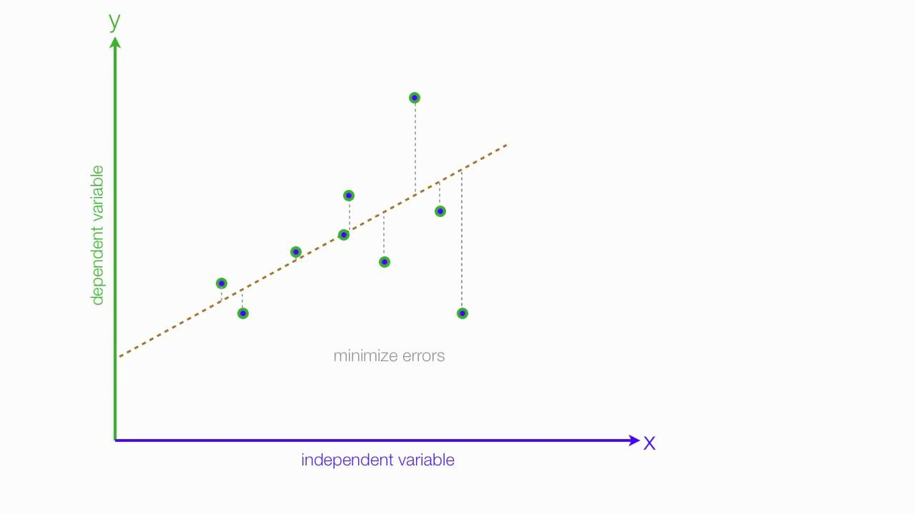
Fit a function

Slide 13
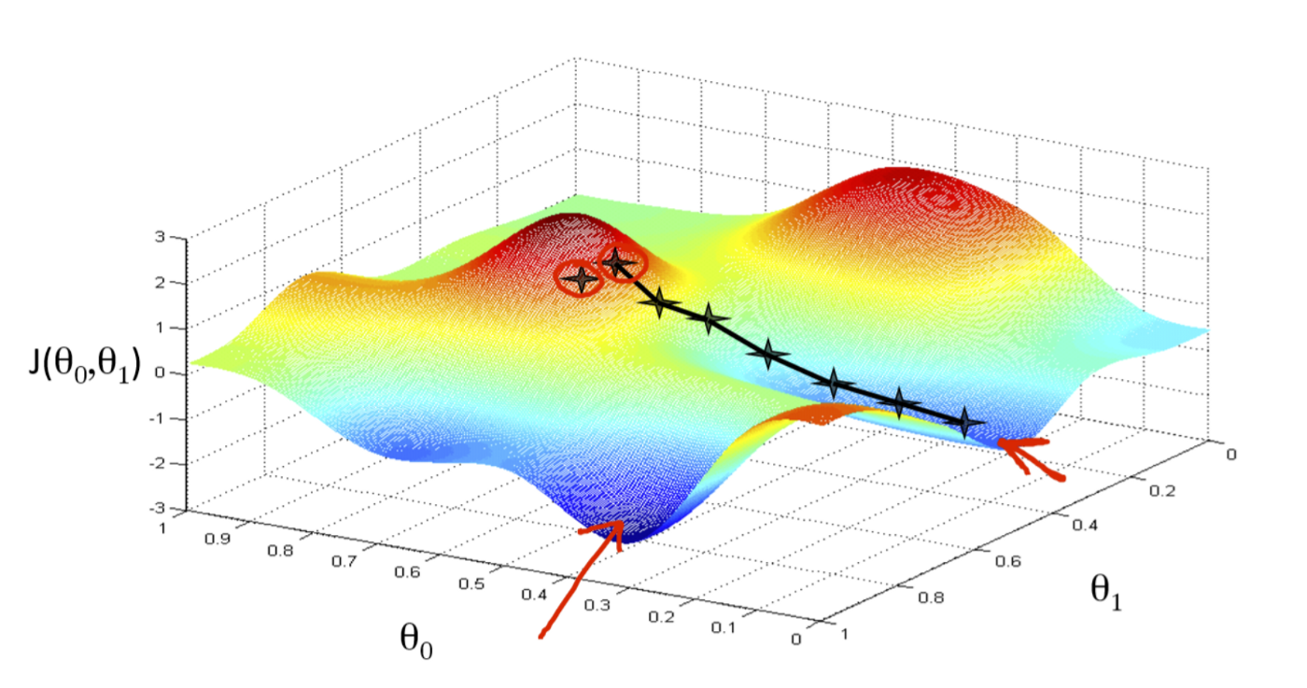
How do we fit?
Source: https://towardsdatascience.com/an-intuitive-explanation-of-gradient-descent-83adf68c9c33

Slide 15

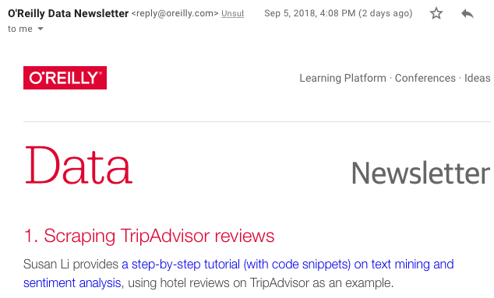
News
O'Reilly Data Newsletter
O'Reilly Artificial Intelligence Newsletter
kdnuggets
towardsdatascience.com

Slide 16
Competitions, Datasets
Kaggle Datasets
data.world
data.gov

